Slide 2
KATALON STUDIO
2019
KMS A+

Slide 3
Contents
Introduction
Demonstration
Web UI Automation
RESTful APIs
Database

Slide 4
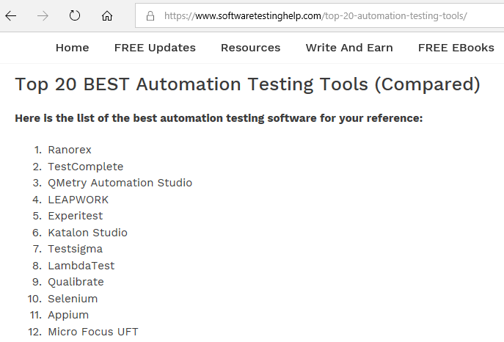
Introduction
Katalon Studio is a Simple and Powerful test automation solution for Mobile, Web, Database and API testing
Cross platforms support Windows, macOS, Linux and popular mobile and browser platforms.
Katalon has over 250K active users, 4000+ weekly downloads; Plug-in store in Q1.2019

Slide 5
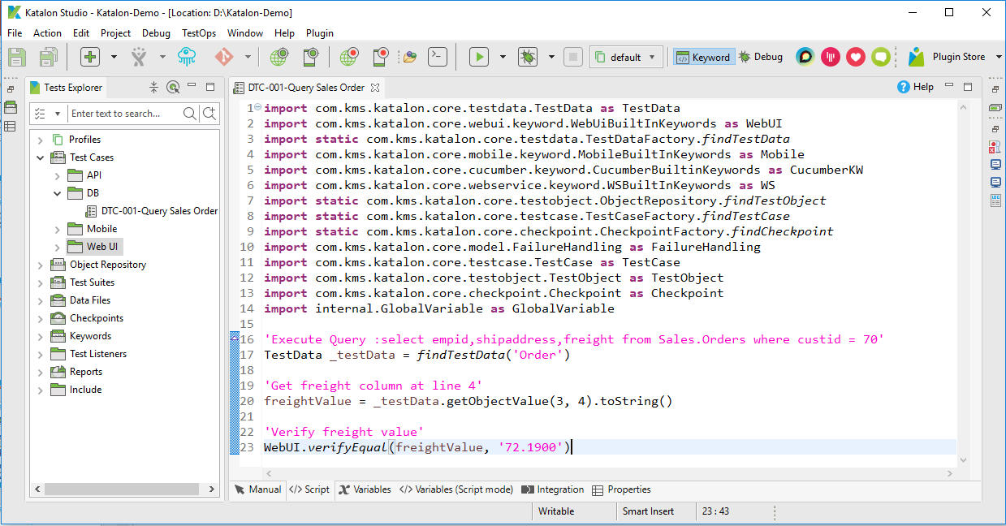
Katalon Studio

Slide 6
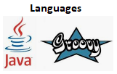







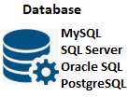








Overview
Automation
Integration
Notes:
The Only Free - Full features automation solution available.
Dual scripting modes enable effective collaboration between manual tester to automation engineers.
Based on Selenium and Appium, the dominant automation stacks with official support for multiple browsers (Chrome, Firefox, IE, Safari, Edge).
100% customer support satisfaction and positive net promoter score.
+ Native integrations with DevOps and CI/CD ecosystems:
Source control system (SVN, GIT…) for collaboration and resources sharing.
ALM Test Management : Katalon Analytics, JIRA, Qtest, TestRail for test result management.
Continuous Integration (CI): Jenkins, Bamboo, Docker systems to kick-off automation execution integration to map automation test to tickets.
Dependency Management: Gradle Plugin
Test clouds (Saucelabs, Browserstack, Kobiton) for test execution.
Slack integration for real-time notification.

Slide 7
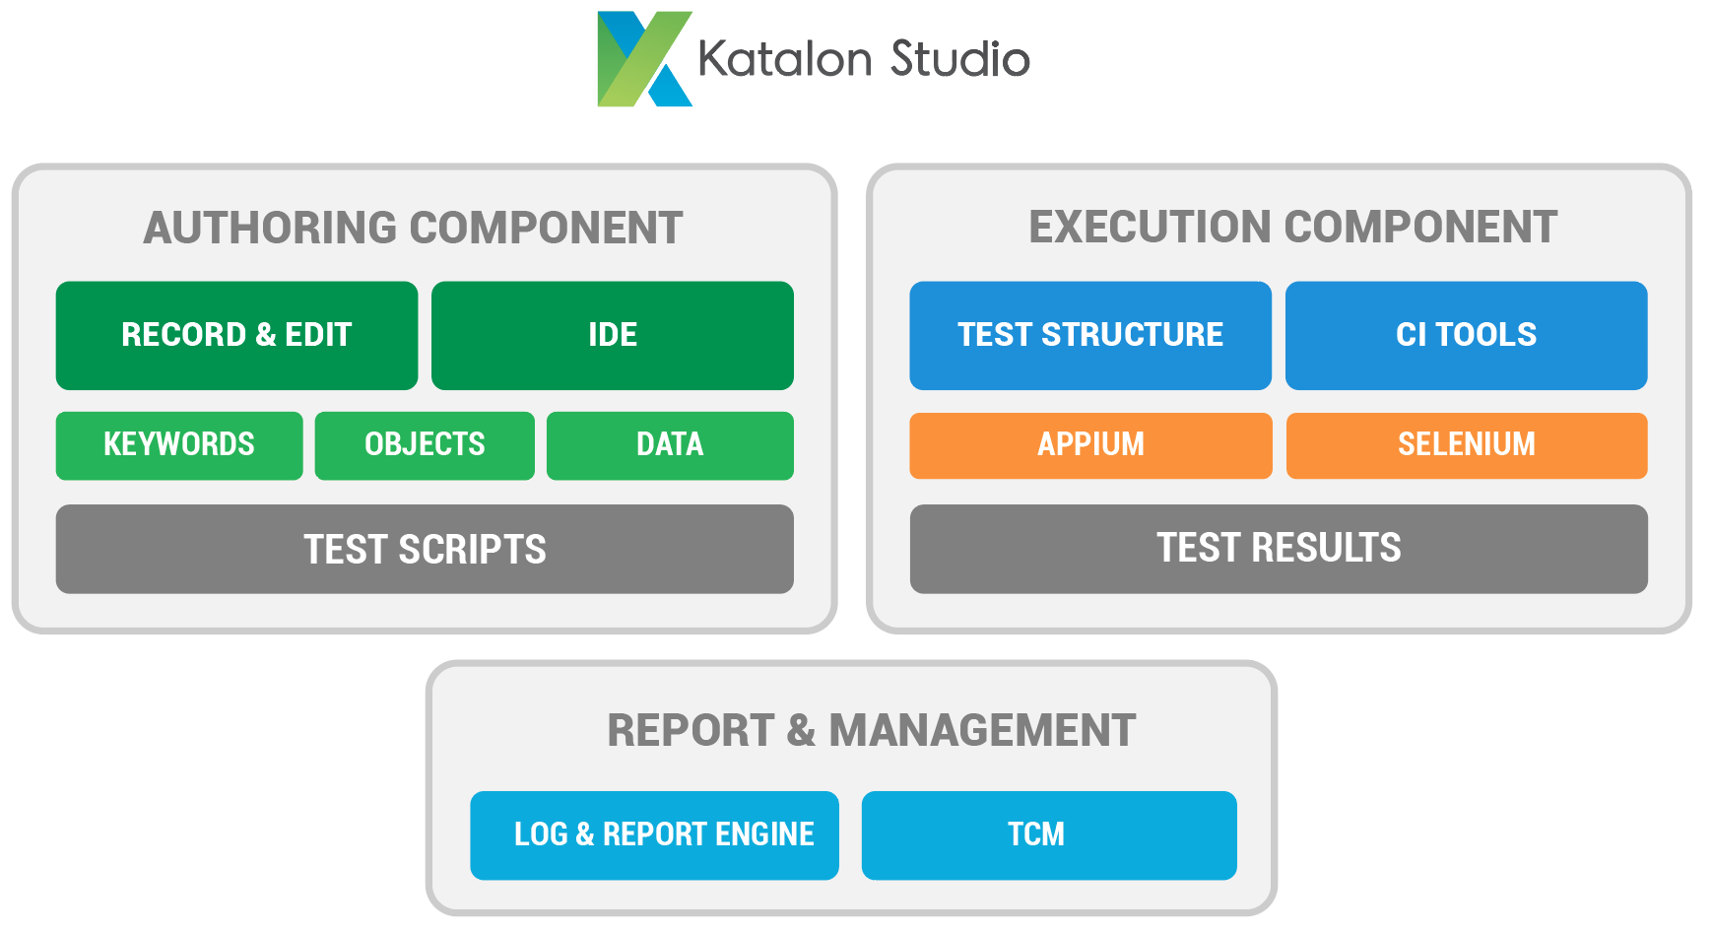
SOLUTION DIAGRAM
Notes:
## Automation Authoring
Test structure management.
Object spy, supporting OS components related to browsers’ activities.
Objects structure repository.
Test recording, auto script generating.
Prebuild keywords, validation methods.
IDE & Editing interface to manipulate test scripts.
Define assertion, test-flow condition, variable.
External data sources: Excel, CSV, DB.
Script debugging.
## Automation Execution
Test execution structure management (multi folders / modules / releases structure).
Direct execution from IDE or from command line.
Export execution parameters, properties file for integration execution.
Report and log file can be emailed for auto execution.
Screenshot capturing on failed step automatically.
Support execution on multiple environments (local, cloud…).
## Automation Report & Management
Automation artifacts are generated & managed as a development project:
Fully compatible with Eclipse IDE
Collaboration & sharing via source control (GIT, SVN)
Custom keywords & libraries imported / built with Katalon or other IDEs
Customizable reports and logs, filterable with multiple formats.
Automate screen capturing on failed steps for quick troubleshooting.
Real-time log viewer with table and tree view.
Katalon Analytics provide historical execution reports and intelligent quality dashboards.

Slide 8
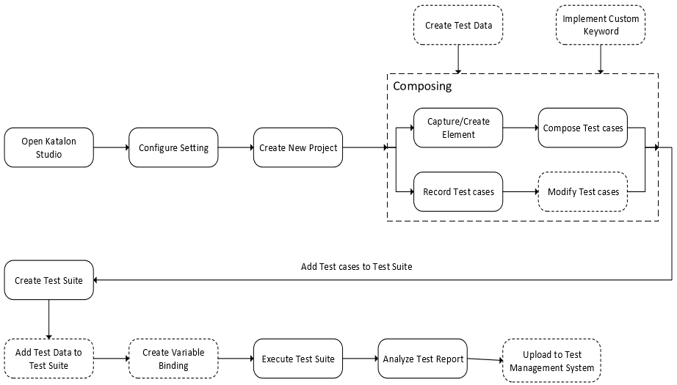
Working Flow

Slide 9
DEMONSTRATION
UI Object
Record
Modify
Use
Write Test Case
Manual
Scripting
Parameters
REST API Test
Scripting
Database
Scripting

Slide 10
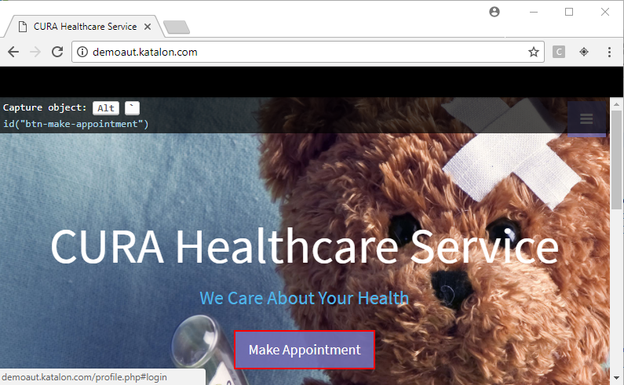
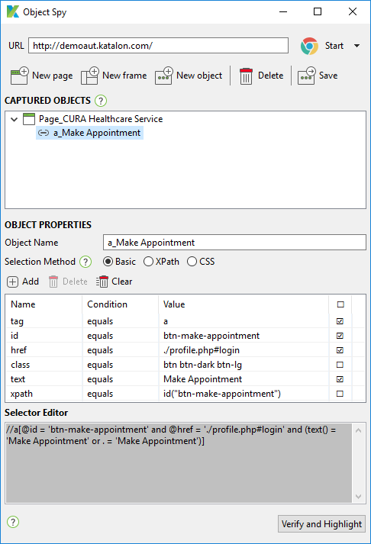
UI Object - Record

Slide 11
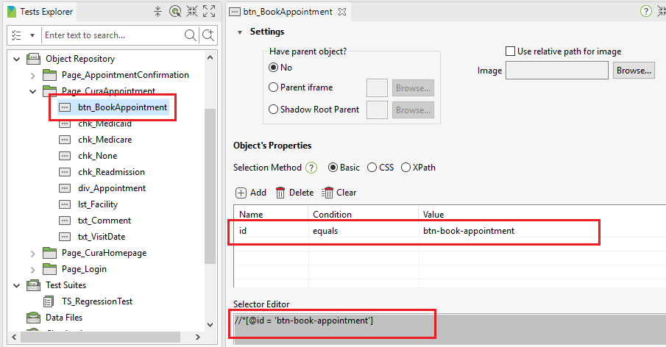
UI Object - Modify

Slide 12
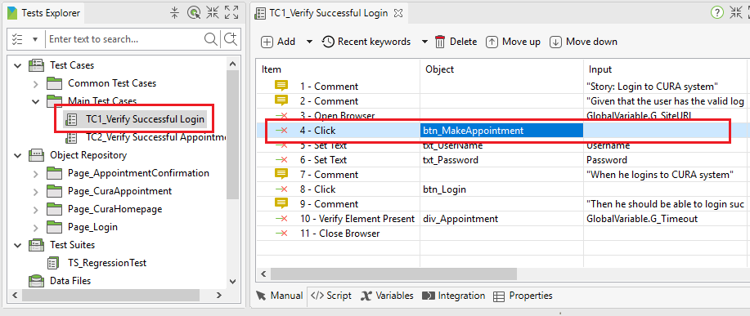
UI Object - Use

Slide 13
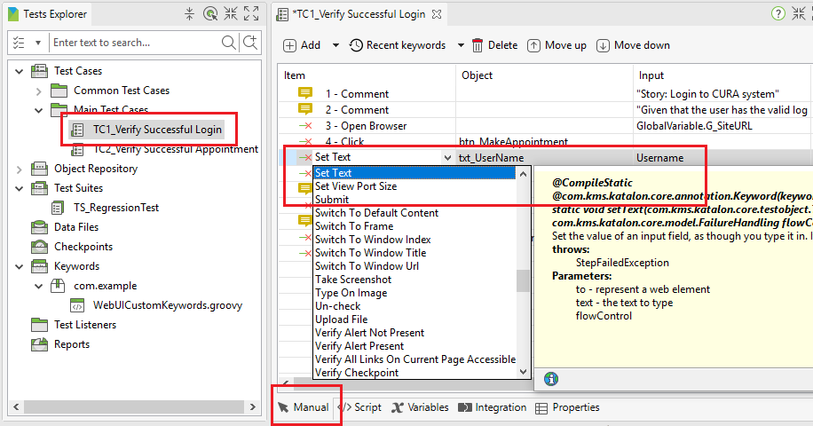
Write Test Case – Manual

Slide 14
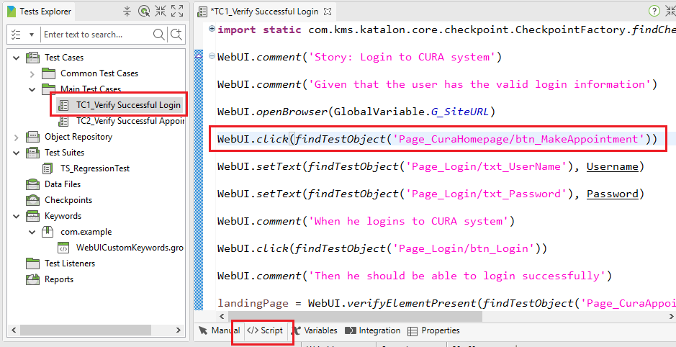
Write Test Case - Scripting
https://www.katalon.com/resources-center/tutorials/create-test-case-using-script-mode/

Slide 15
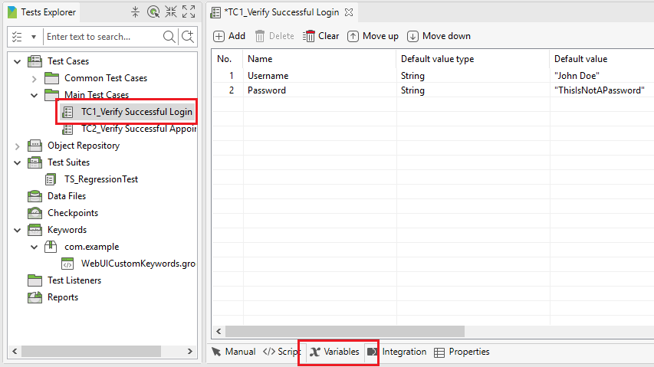
Write Test Case - Parameters

Slide 16
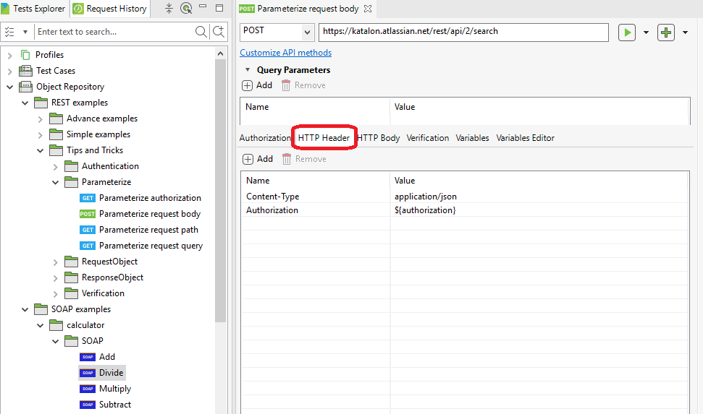
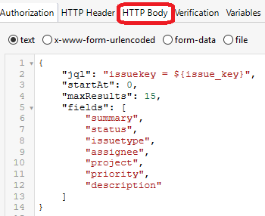
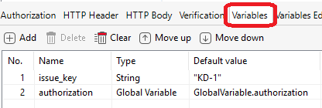
REST API TEST - Object
http://jsonplaceholder.typicode.com/

Slide 17
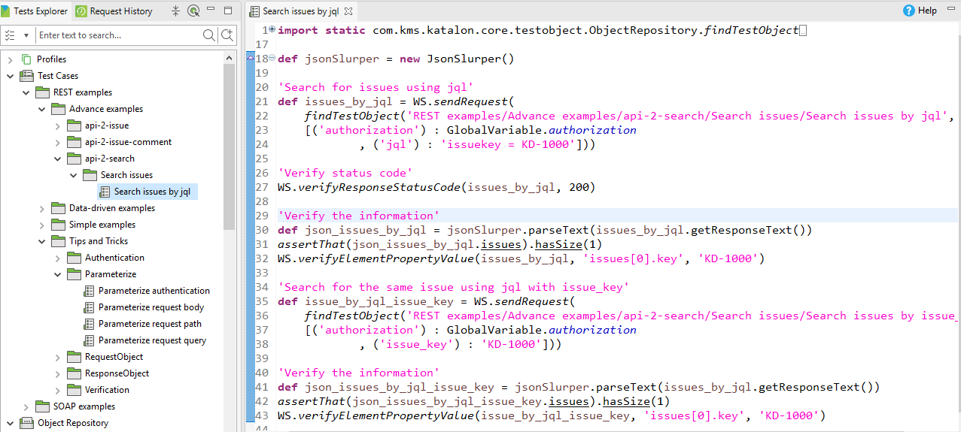
REST API TEST - Scripting

Slide 18
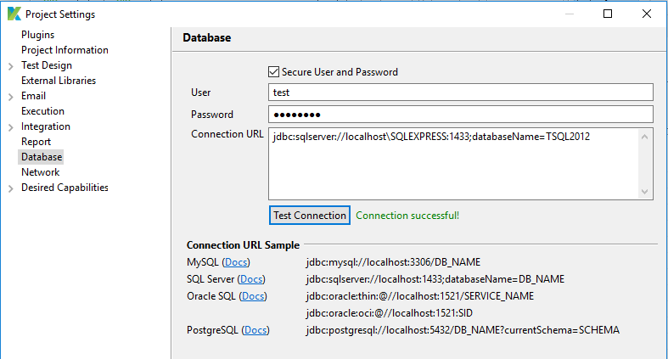
Database - Setting

Slide 19
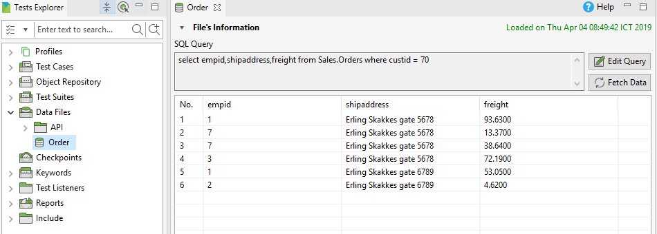
Database - Object

Slide 20
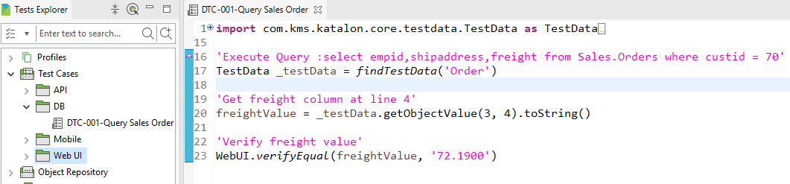
Database - Scripting

Slide 21
Q&A

Slide 22
References
https://www.katalon.com/
https://www.youtube.com/watch?v=zsWBND0pxjs
https://www.youtube.com/watch?v=ej_xay0acDY&list=PL6tu16kXT9Po015vNjMIvbhZPAA6O-mT4
https://docs.katalon.com/katalon-studio/docs/record-web-utility.html#record
https://www.softwaretestinghelp.com/top-20-automation-testing-tools/

Slide 23
THANK YOU

